Slide 1
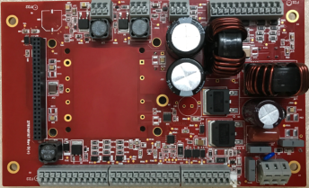
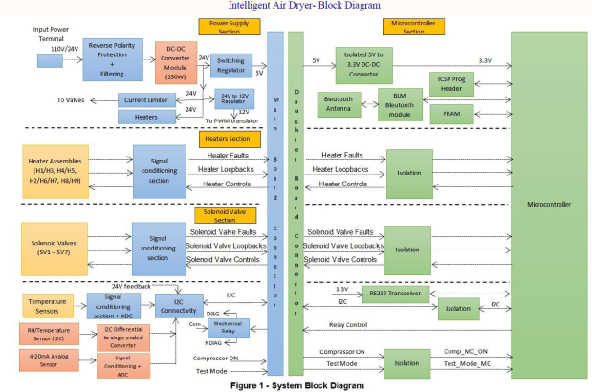
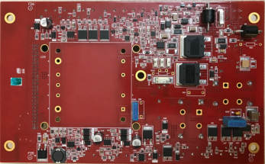
Division: GSFE
Division: GSFE
Intelligent Air Dryer - Redesign
Scope
Customer has developed versions of Controller board (up to Rev.C) for Intelligent Air Dryer product which failed in EMI/EMC.
The requirement was to Design and Develop a control board for the Intelligent Air Dryer product with two variants – 110VDC input and 24VDC input. Power and Controller boards are to be designed as separate boards and then stacked. The project scope included the following:
Hardware Design
Firmware Design
Software Design
Prototyping, Testing
Challenges
Documentation not available for Firmware, Software and Firmware used in the product
Environment
Altium
Schematic Guidelines – Schematics and PCB Layout
Compliance to Standards – EN50155, EN50128
Derating Analysis
MTBF Analysis
LTSpice
MPLAB X
Visual Studio (GUI)
Benefits and Improvements
Solution
Hardware, firmware completely owned by POEC.
End to End development of controller board.

